Slide 1
Learning Day : Design Patterns
23/7/2014

Slide 2
Agenda
Some background to Design Patterns
The Strategy Pattern
The Decorator Pattern

Slide 3
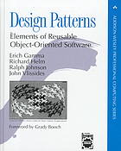
Introduction Design Patterns
Design Patterns are general solutions to recurring problems
First Introduced in the field of Architecture in 1977
Software design patterns – “Design Patterns”, 1994, by Gamma, Helm, Johnson and Vlissides – ‘Gang Of Four’
23 classic software design patterns
under 3 categories : Creational, Structural, Behavioural
First patterns catalog - each pattern description follows a template

Slide 4
The GoF Design Patterns
Creational
Abstract Factory
Structural
Adaptor
Bridge
Behavioural
Command
Interpreter
Builder
Factory Method
Prototype
Singleton
Composite
Decorator
Façade
Flyweight
Proxy
Iterator
Mediator
Memento
Observer
State
Strategy
Template Method
Visitor
Chain of responsibility

Slide 5
Design Patterns and OO
GoF design patterns are based on experiences designing object oriented systems
Make use of OO concepts such as
Inheritance
Polymorphism
Encapsulation
Abstraction

Slide 6
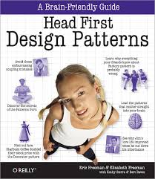
Good book to start learning more about design patterns…
Detailed description and examples for the core GoF patterns
Highlights the Object Oriented design principles on which the patterns are based.
Endorsed by Erich Gamma and Richard Helm

Slide 7
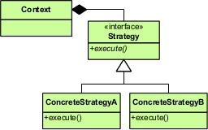
The Strategy Pattern
The Strategy Pattern defines a family of algorithms, encapsulates each one, and makes them interchangeable. Strategy lets the implementation vary independently from the clients that use it.

Slide 8
Example : A Duck simulator
Duck
swim()
Problem – not all Duck subclasses should fly!
display()
One solution: Override fly() in subclasses. This will introduce duplicate code and costs if implementation needs to be change across many sub classes!
fly()
MallardDuck
RedheadDuck
DecoyDuck
display() {
// show a mallard
}
display() {
// show a redhead
}
…
display() {
// show decoy
}

Slide 9
Some problems using inheritance
Over time, Duck behaviours may need to change => may need to update code in many Duck classes
Duck behaviours may change for different sub classes
Design Principle Identify aspects of the application that vary and separate them from what stays the same or Encapsulate what varies

Slide 10
…con’t
Some behaviours are not appropriate for all sub classes
Design principle
Favour composition over inheritance
The Duck behaviour is not dynamic – it is set at compile time, not during run time
Design principle Program to an interface, not an implementation

Slide 11
Apply the design principles
Encapsulate
Encapsulate fly behaviours in separate classes
Interface
Behaviour classes inherit from an interface
Compositition
Duck ‘HAS-A’ fly behaviour

Slide 12
Encapsulated Fly behaviour
Duck
‘HAS-A’
FlyBehaviour
FlyBehaviour flyBehaviour
fly()
swim()
display()
FlyWithWings
FlyNoWay
performFly()
fly(){
// implement duck flying
}
fly(){
// do nothing
}
setFlyBehaviour()
‘IS-A’
MallardDuck
RedheadDuck
DecoyDuck
display() {
// show a mallard
}
display() {
// show a redhead
}
display() {
// show decoy
}

Slide 13
Benefits
Provides a choice of implementations of a behaviour
Implementation details of a particular fly behaviour may be changed without impacting Duck classes
New fly behaviours may be added without impacting code in the Duck classes
A Duck’s fly behaviour can be changed during run time

